Slide 1


BUCA FACULTY OF EDUCATION
STUDY IN TURKEY:
COUNSEL OF HIGHER EDUCATION VIRTUAL FAIR 2020
JULY 20, 2020

Slide 2


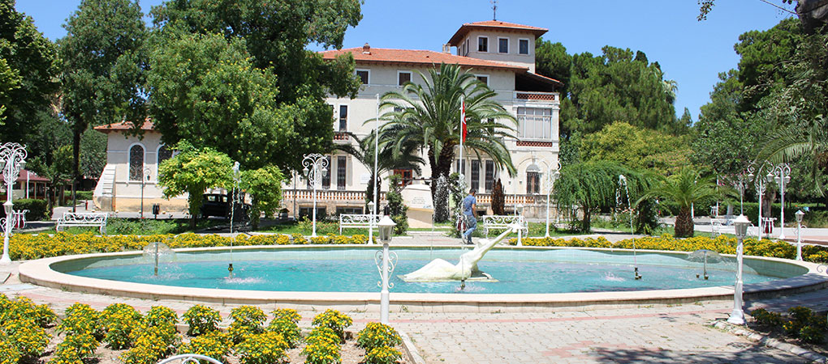
BUCA FACULTY OF EDUCATION
110.000 m² campus
Located in Buca, IZMIR

Slide 3
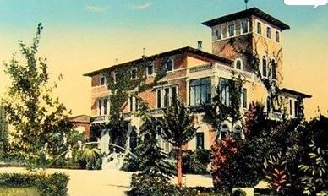
Brief History
Buca Faculty of Education has a long history of teacher education, dating back to1959.
In 1959, the Rees Mansion, which now serves as the Dean’s Office, was selected as construction site for the new teacher training school and started to serve as Izmir Girls’ Education Institute.
After a restructuring in 1979, Izmir Girls’ Education Institute was renamed as Izmir (Buca) Higher Teacher Education School and started to prepare teachers for high schools.
In 1982, Buca Higher Teacher Education School became a faculty affiliated with Dokuz Eylül University. Since then, it continues to prepare prospective teachers in a wide range of fields.

Slide 4
Vision & Mission
Buca Faculty of Education aims to develop teachers who contribute to the social, cultural, economic, scientific and technological advancement of our nation and humanity, by achieving universal standards in teacher education.
With its productive and innovative academic staff who achieve international academic standards through research projects, as well as art and cultural activities, Buca Faculty of Education strives to develop teachers and researchers who follow new trends in educational sciences and technology and who can effectively cooperate with other educational stakeholders.

Slide 5
Brief Overview
Buca Faculty of Education is one of the leading schools of education in Turkey with:
  8 departments & 25 academic programs
  189 faculty members
    45 full professors
    49 associate professors
    40 assistant professors
    25 lecturers
    30 research assistants
  42 staff
  5778 students

Slide 6
Academic Departments
Computer and Instructional Technologies Education
Educational Sciences
Fine Arts Education
Foreign Language Education
Mathematics and Science Education
Primary Education
Special Education
Turkish and Social Fields Education

Slide 7
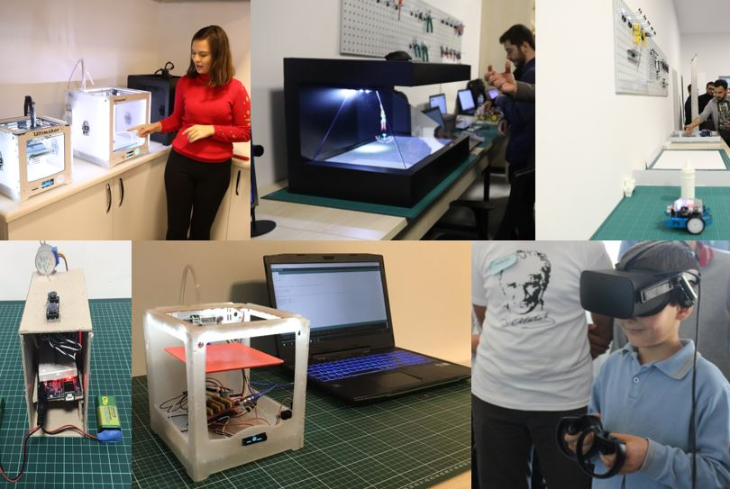
Department of Computer and Instructional Technologies Education
Computer and Instructional Technologies Education
11 Faculty Members
  - 1 full professor
  - 2 associate professors
  - 2 assistant professors
  - 4 lecturers
  - 2 research assistants
174 Students

Slide 8
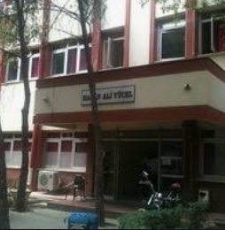
Department of Educational Sciences
Curriculum and Instruction
Educational Administration
Educational Measurement and Evaluation
Guidance and Psychological Counseling
23 Faculty Members
  - 7 full professors
  - 7 associate professors
  - 6 assistant professors
  - 1 lecturer
  - 2 research assistants
341 Students

Slide 9
Department of Fine Arts Education
Music Education
Painting & Crafts Education
27 Faculty Members
  - 2 full professors
  - 9 associate professors
  - 3 assistant professors
  - 10 lecturers
  - 3 research assistants
436 Students
The Division of Music Education is situated in its own building and includes:
5 classrooms
30 student study rooms
1 rehearsal room
1 concert hall
1 library
The Division of Painting & Crafts Education is situated in its own building and includes:
7 painting, 3 printmaking, 1 silkscreen, 1 lithography, 3 graphic design, 2 sculpture, 1 drawing, and 1 photography project studios
1 art history and 1 art teaching lab
1 multipurpose conference hall
2 art galleries
1 archive

Slide 10
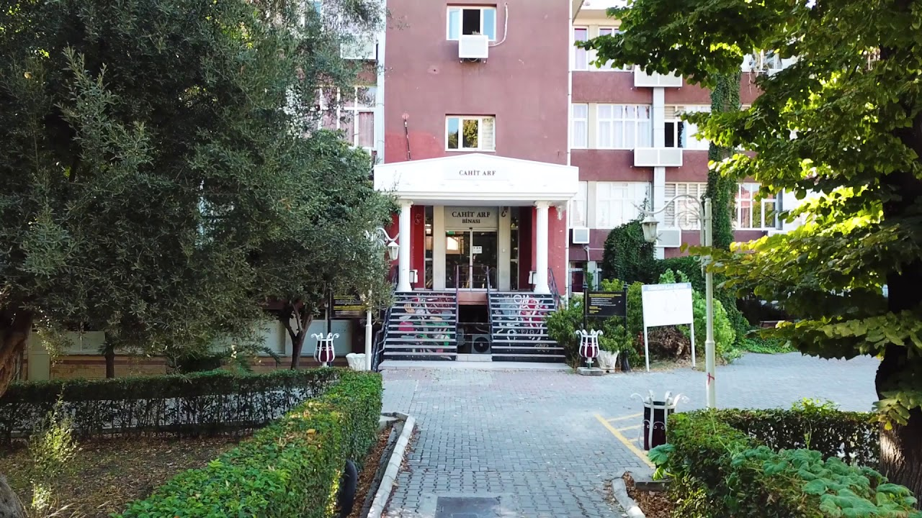
Department of Foreign Language Education
English Language Education
French Language Education
German Language Education
24 Faculty Members
  - 3 full professors
  - 4 associate professors
  - 9 assistant professors
  - 4 lecturers
  - 4 research assistants
1182 Students

Slide 11
Department of Mathematics and Science Education
Biology Education
Chemistry Education
Mathematics Education
  Elementary Mathematics Teaching Program
  Secondary Mathematics Teaching Program
Physics Education
Science Education
47 Faculty Members
  - 19 full professors
  - 12 associate professors
  - 6 assistant professors
  - 2 lecturers
  - 8 research assistants
1148 Students

Slide 12
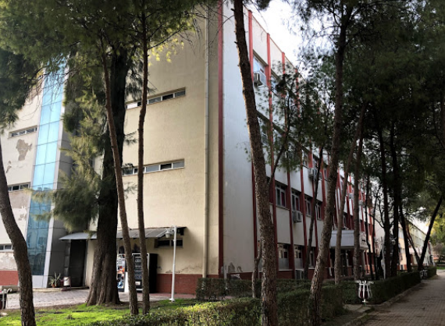
Department of Primary Education
Early Childhood Education
Elementary Education
17 Faculty Members
  - 4 full professors
  - 4 associate professors
  - 8 assistant professors
  - 1 lecturers
902 Students

Slide 13
Department of Special Education
Gifted Education
Mentally Disabled Children Education
11 Faculty Members
  - 3 full professors
  - 1 associate professors
  - 2 assistant professors
  - 1 lecturer
  - 4 research assistants
354 Students

Slide 14
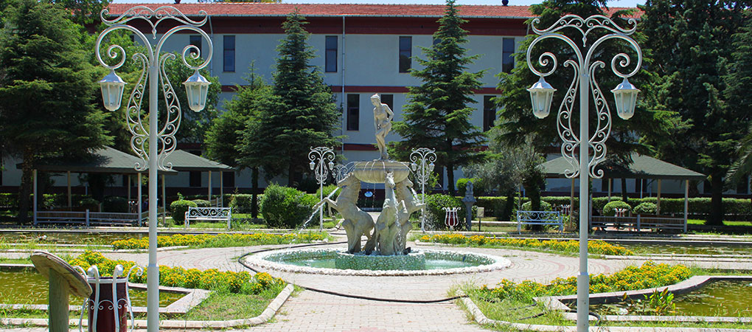
Department of Turkish and Social Fields Education
Geography Education
History Education
Social Studies Education
Turkish Language and Literature Education
Turkish Language Education
31 Faculty Members
  - 6 full professors
  - 12 associate professors
  - 4 assistant professors
  - 2 lecturers
  - 7 research assistants
1145 Students

Slide 15
International Exchange Programs
Buca Faculty of Education participates in ERASMUS Students and Scholars Exchange Program, thus allows the exchange of students and academics with internationally recognized institutions.
Countries that we have bilateral agreements with:
      Belgium
      France
      Finland
      Germany
      Hungary
      Latvia
      Lithuania
      Poland
      Portugal
      Romania
      Spain
Student mobility: 280
  199 outgoing students
  81 incoming students
Teaching staff mobility: 66
  40 outgoing staff
  26 incoming staff

Slide 16
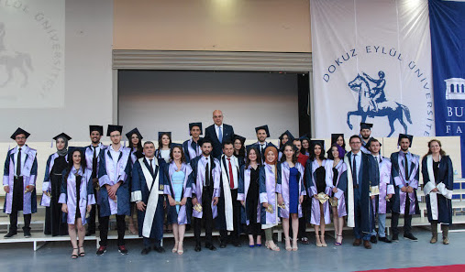
Occupational Profiles of Graduates
Graduates of Buca Faculty of Education enjoy productive careers in public and private schools run by the Ministry of National Education as teachers &
in many other areas of the public service as civil servants or
researchers at universities.

Slide 17
Occupational Profiles of Graduates
Graduates of Division of Psychological Counseling and Guidance may also work in private psychological counseling and psychotherapy centers as counselors. In addition to these, they may work in the institutes run by the government such as police departments, health departments, navy and justice departments.
Graduates of Division of Painting & Crafts Education may also work in graphic and advertisement agencies; in media like newspaper, magazine, production and publication firms and televisions as designer or operator; and in museums, libraries and art galleries.
Graduates of Foreign Language Education programs may also work in museums, libraries and archives as researchers and senior advisers.

Slide 18
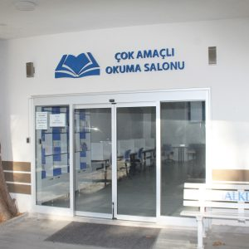
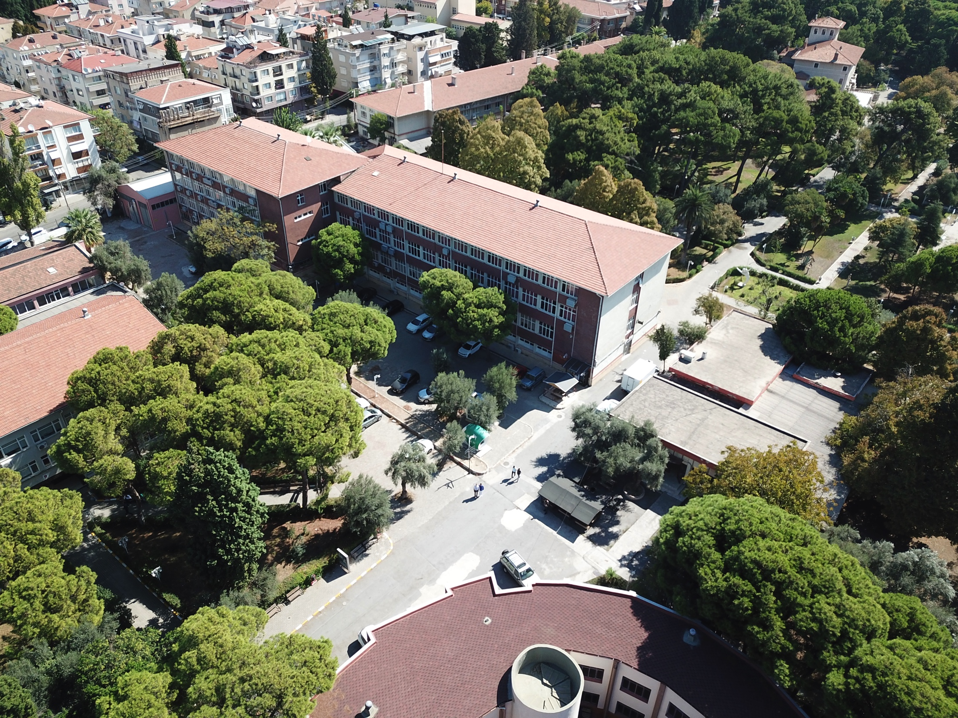
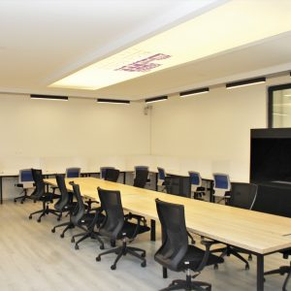
Campus Resources
Multi purpose study room
6 buildings, 81 classrooms
Library

Slide 19
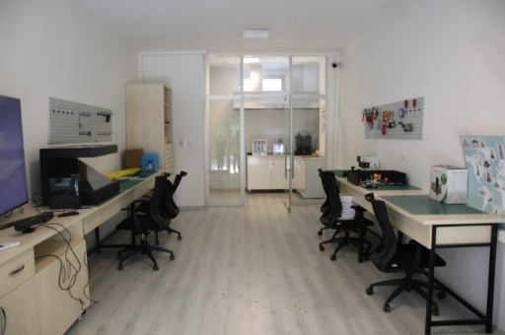
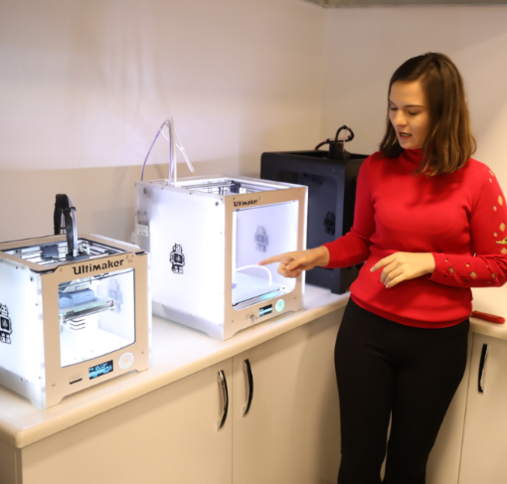
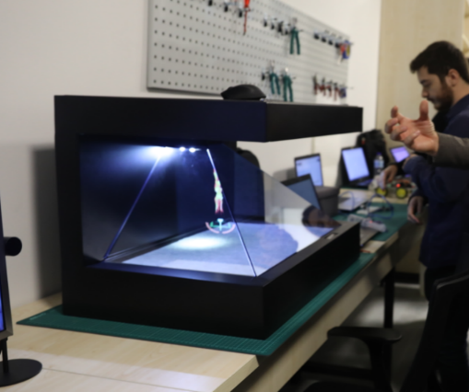
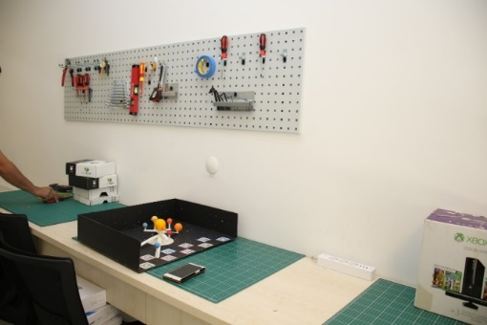
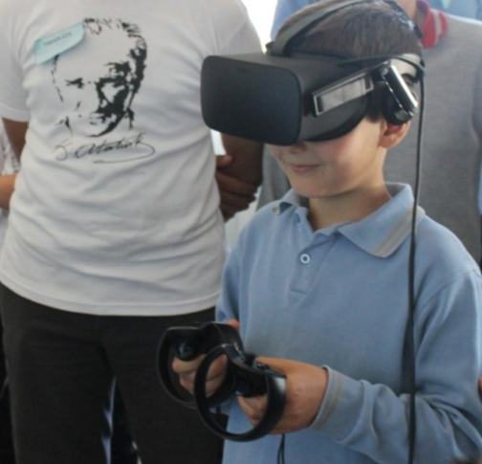
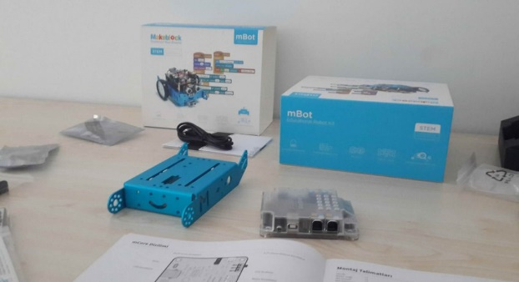
Campus Resources
LABORATORIES
Instructional Technologies Research & Development Laboratory
3D printers
robotic sets
hologram devices
virtual reality technologies
augmented reality technologies

Slide 20
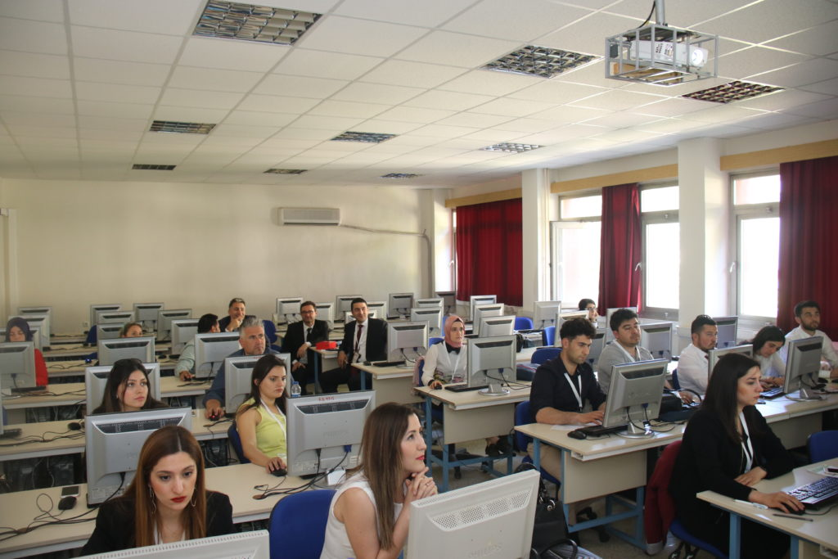
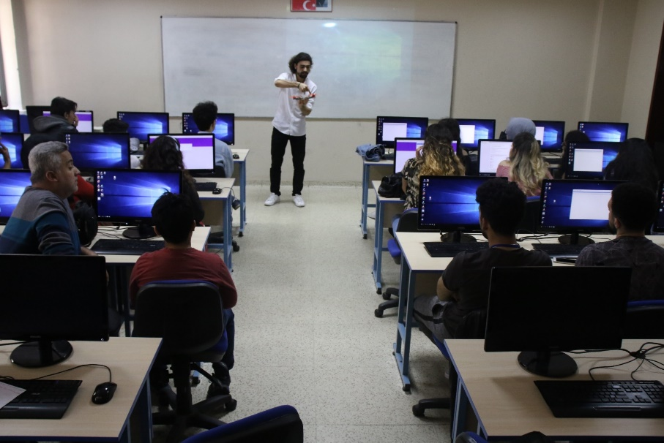
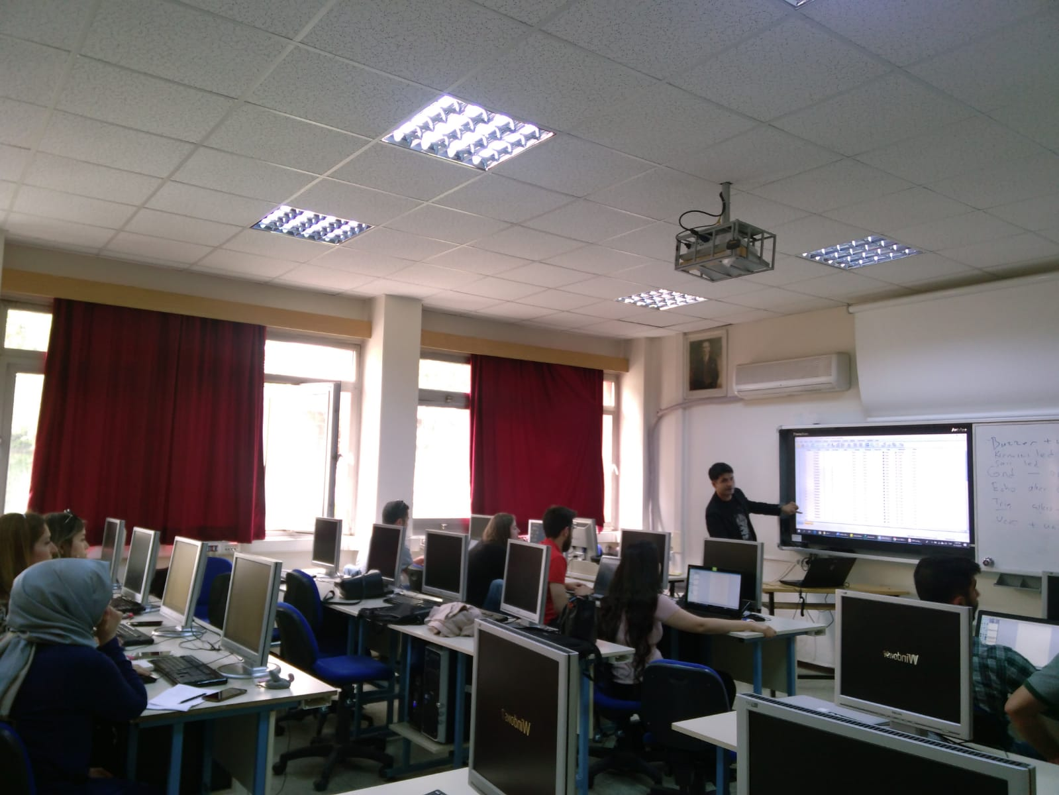
Campus Resources
LABORATORIES
6 Computer Labs

Slide 21
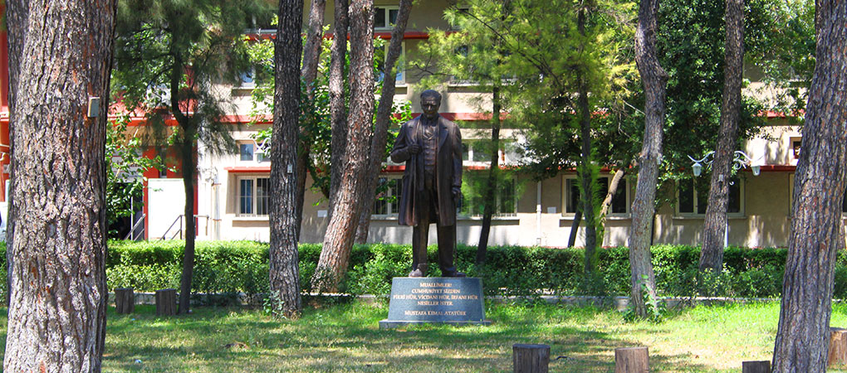
Campus Resources
LABORATORIES
13 Physics, Biology, Chemistry, and Science Laboratories

Slide 22
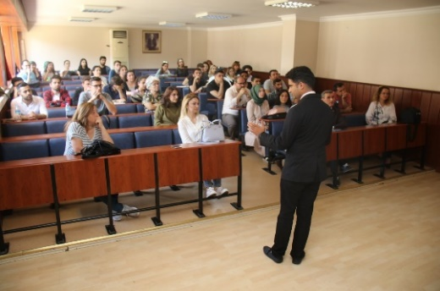
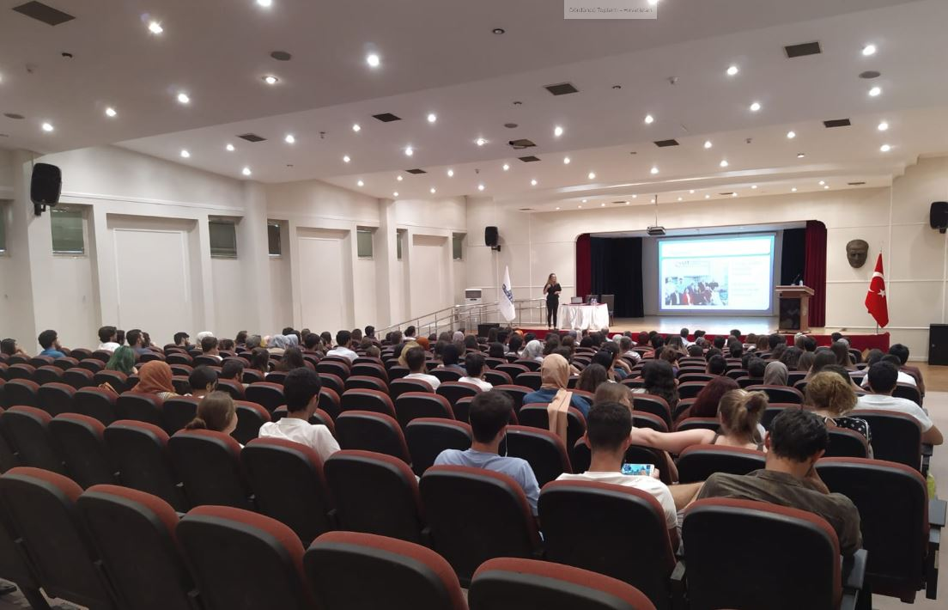
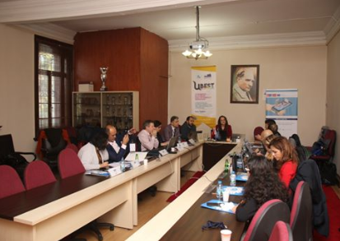
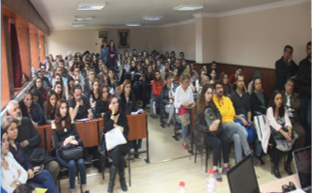
Campus Resources
CONFERENCE AND MEETING SPACE
Conference Hall
4 Meeting Halls

Slide 23
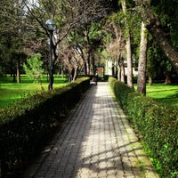
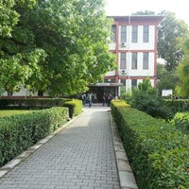
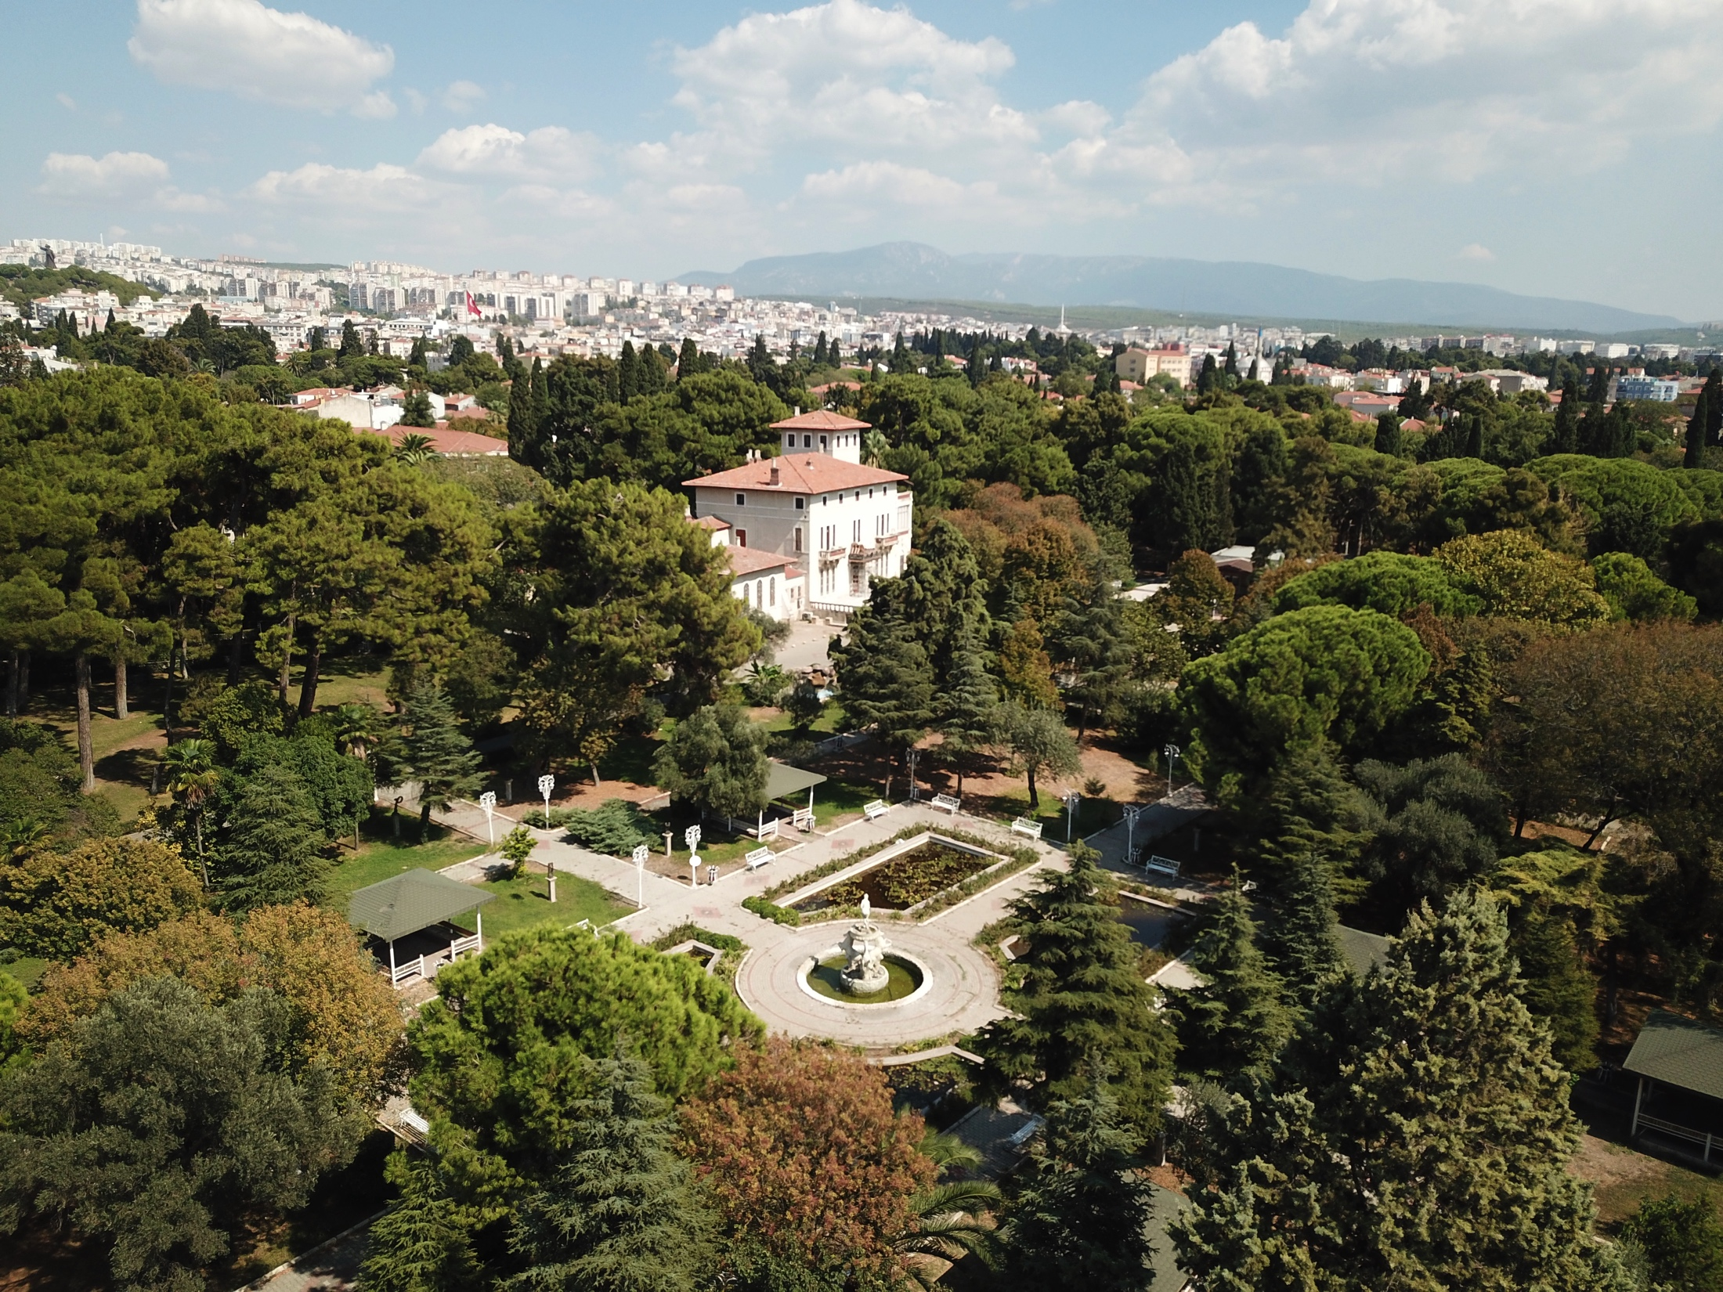
Campus Resources
Dining Hall
3 Cafeteria
Indoor Sports Facility
Astroturf Soccer Field

Slide 24
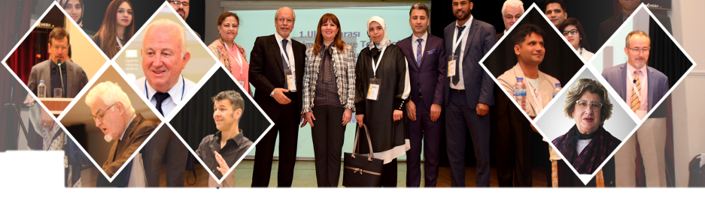
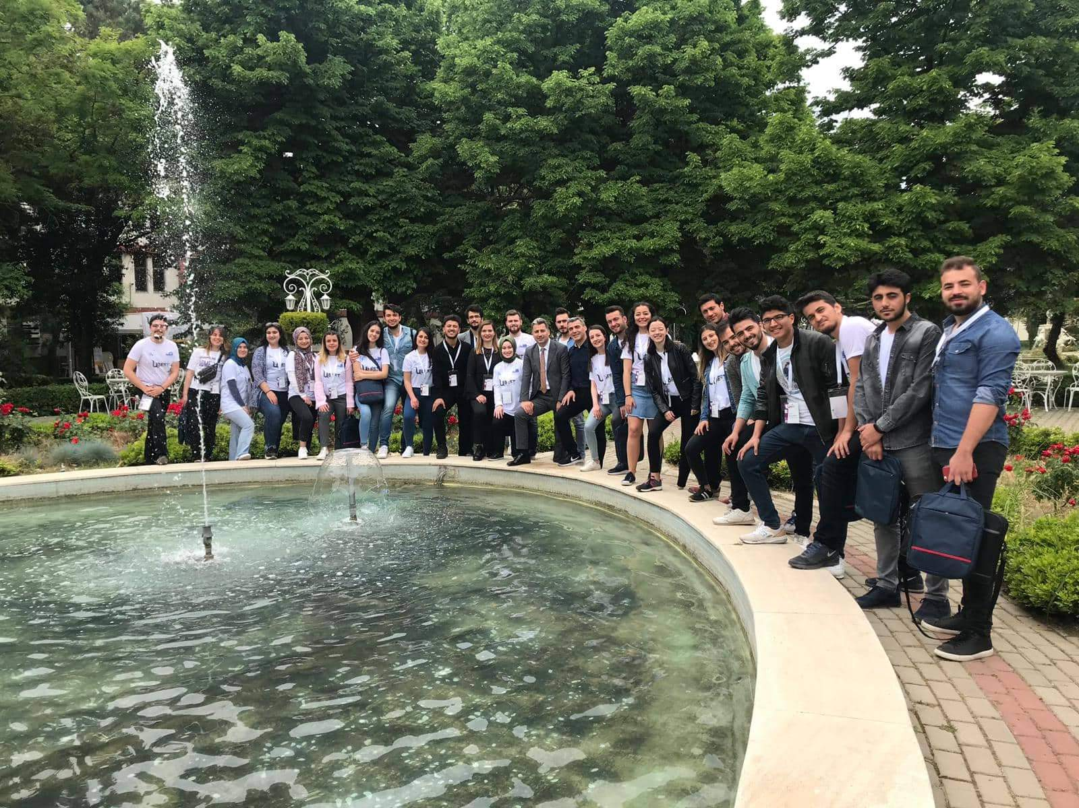
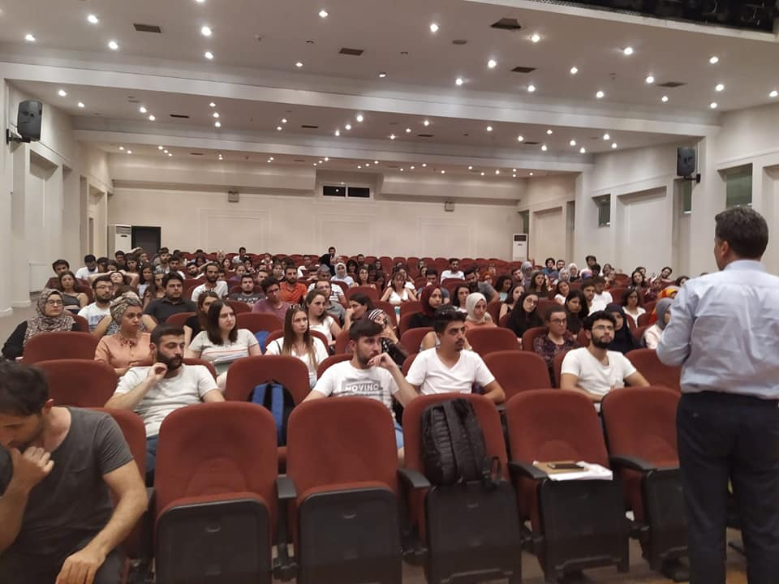
Campus Life
Throughout the academic year, our campus hosts a variety of academic, social, and cultural events.
1st International Science, Education, Art, and Technology Symposium
European Research Project: EDUCODE Workshop

Slide 25

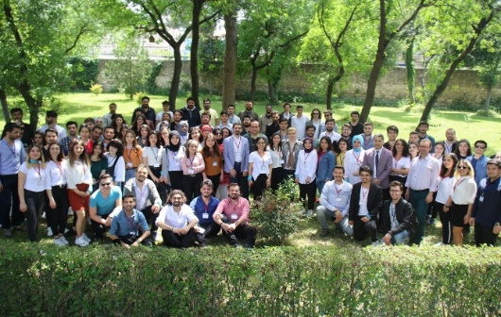
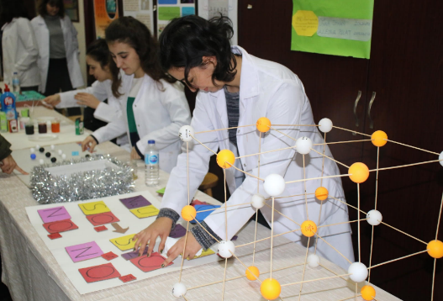
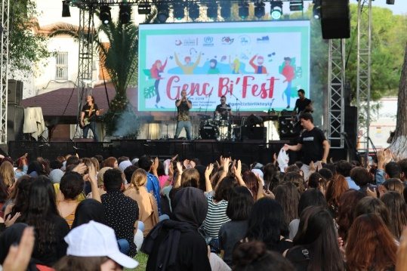
13th Computer and Instructional Technologies Student Congress
Instructional Materials Exhibition
Student Festival:
Genç Bi’ Fest

Slide 26
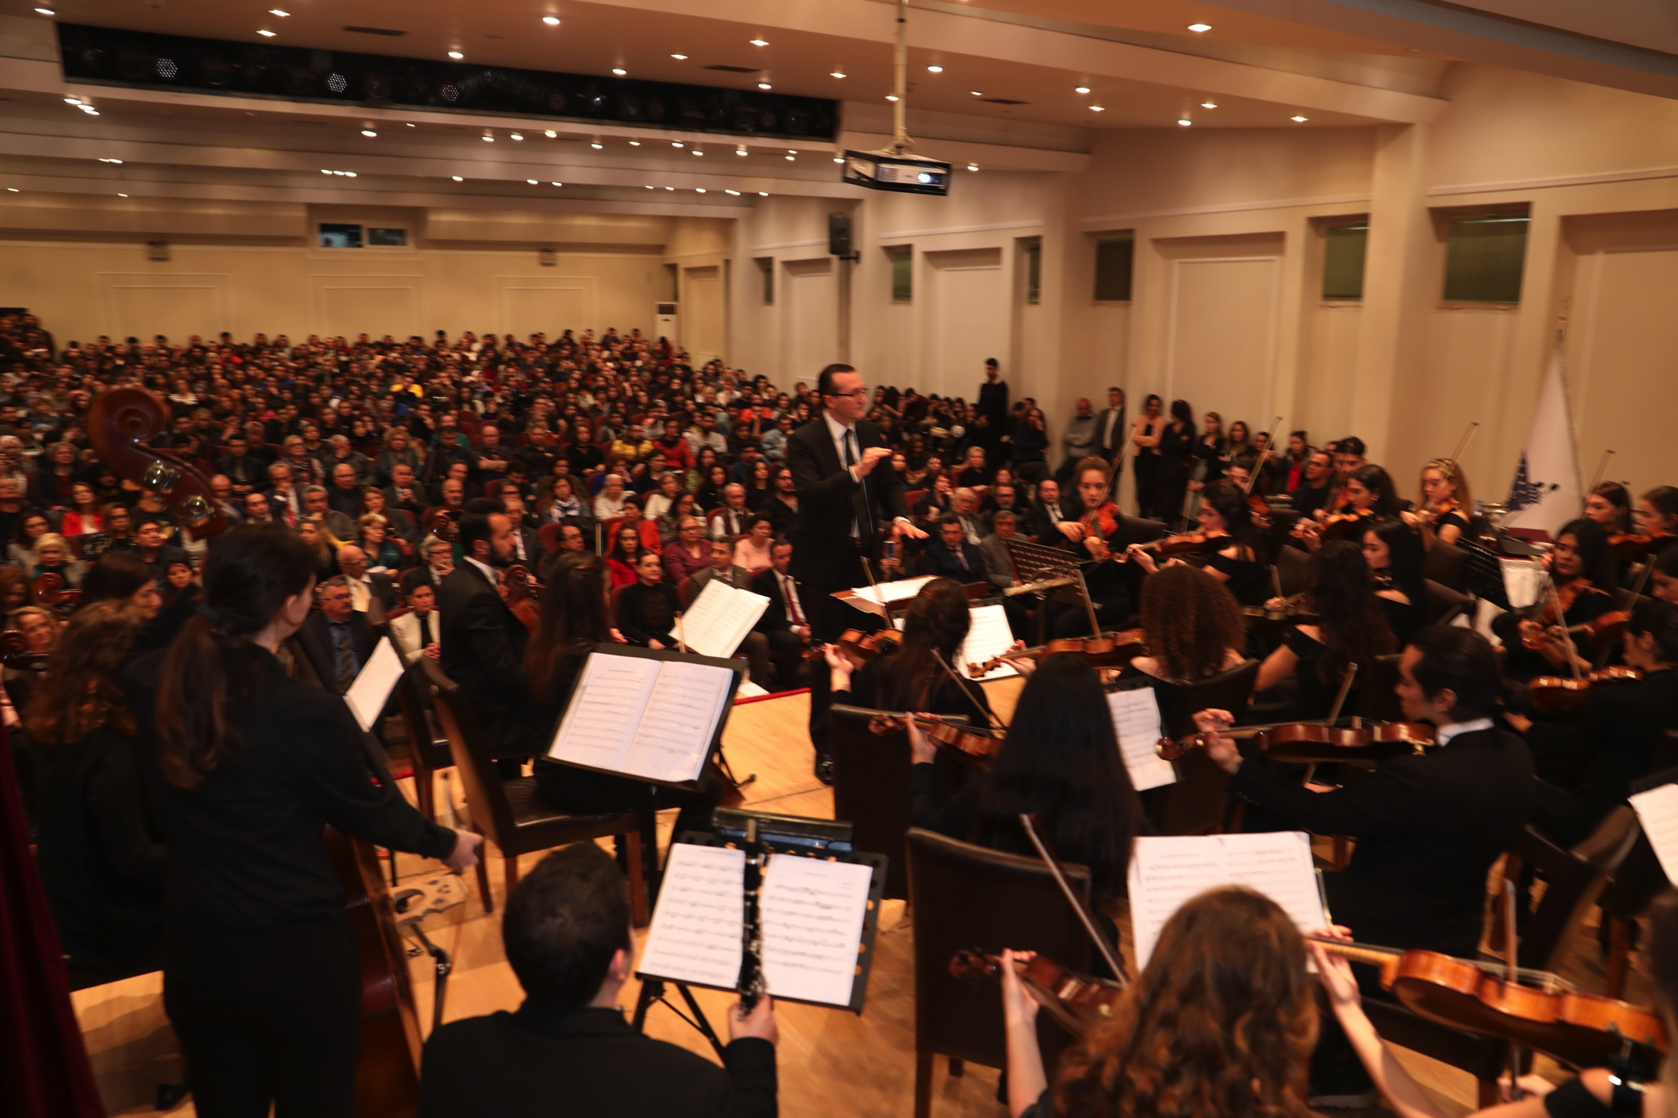
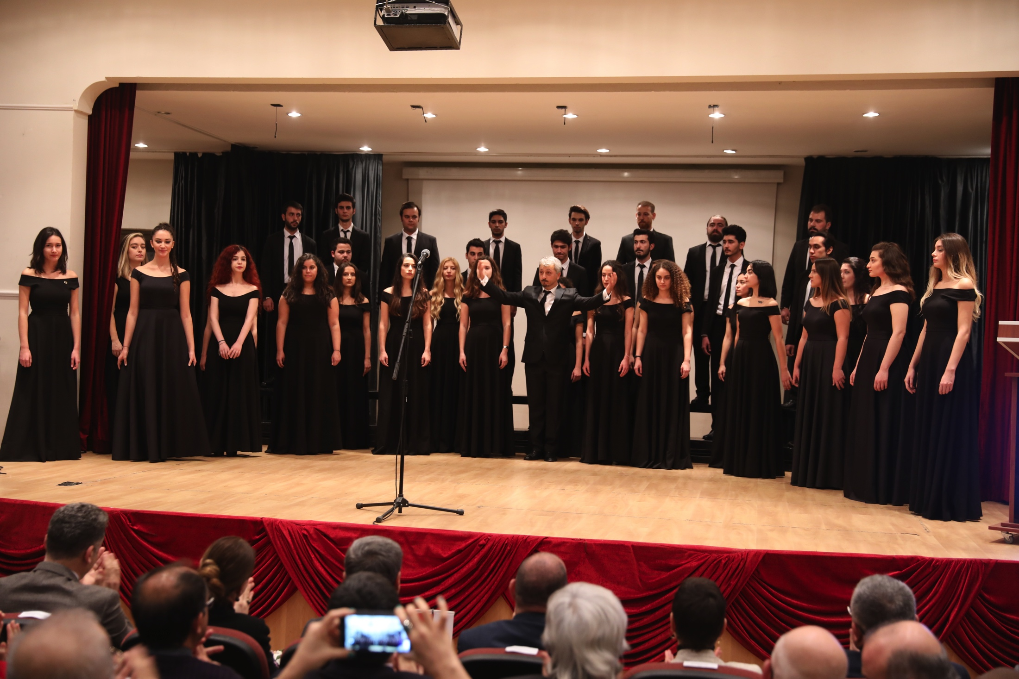
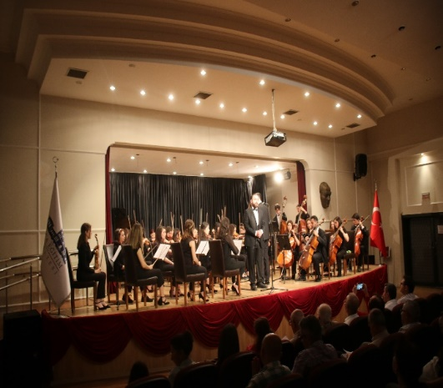

Slide 27
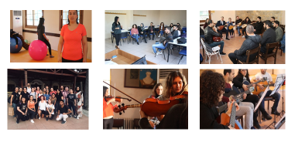
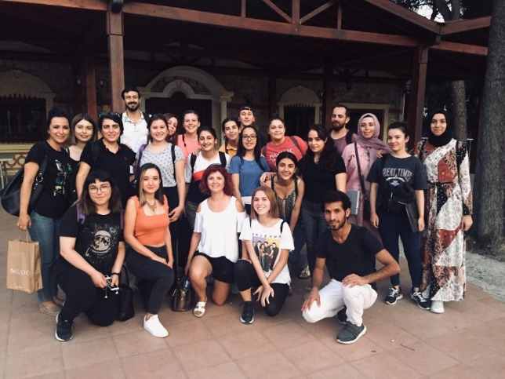
In support of lifelong learning, free, certified courses for students and academic staff
Drama course
Guitar course
Violin course
Diction course
Sign language course
Folk dance course
Pilates course
Kick-box course
Taekwondo course

Slide 28
Thank you for your interest!
Please check out the following link for further information about the university and admissions such as tuition fees, accepted exams and diplomas for international students, and so on..
http://deyos.deu.edu/tr/en
You can also attend the live Q & A session during the virtual fair and
ask your questions directly to the specialists in our
International Relations Office.

